Slide 1
Mobile Communications
Chapter 9: Mobile Transport Layer
Motivation
TCP-mechanisms
Classical approaches
  Indirect TCP
  Snooping TCP
  Mobile TCP
  PEPs in general
Additional optimizations
  Fast retransmit/recovery
  Transmission freezing
  Selective retransmission
  Transaction oriented TCP
TCP for 2.5G/3G wireless

Slide 2
Transport Layer
E.g. HTTP (used by web services) typically uses TCP
  Reliable transport between client and server required
TCP
  Steam oriented, not transaction oriented
  Network friendly: time-out
  ➔ congestion
  ➔ slow down transmission
Well known – TCP guesses quite often wrong in wireless and mobile networks
  Packet loss due to transmission errors
  Packet loss due to change of network
Result
  Severe performance degradation
Client
Server
TCP SYN
TCP SYN/ACK
Connection
setup
TCP ACK
HTTP request
Data
transmission
HTTP response
>15 s
no data
GPRS: 500ms!
Connection
release

Slide 3
Motivation I
Transport protocols typically designed for
  Fixed end-systems
  Fixed, wired networks
Research activities
  Performance
  Congestion control
  Efficient retransmissions
TCP congestion control
  packet loss in fixed networks typically due to (temporary) overload situations
  router have to discard packets as soon as the buffers are full
  TCP recognizes congestion only indirect via missing acknowledgements, retransmissions unwise, they would only contribute to the congestion and make it even worse
  slow-start algorithm as reaction

Slide 4
Motivation II
TCP slow-start algorithm
  sender calculates a congestion window for a receiver
  start with a congestion window size equal to one segment
  exponential increase of the congestion window up to the congestion threshold, then linear increase
  missing acknowledgement causes the reduction of the congestion threshold to one half of the current congestion window
  congestion window starts again with one segment
TCP fast retransmit/fast recovery
  TCP sends an acknowledgement only after receiving a packet
  if a sender receives several acknowledgements for the same packet, this is due to a gap in received packets at the receiver
  however, the receiver got all packets up to the gap and is actually receiving packets
  therefore, packet loss is not due to congestion, continue with current congestion window (do not use slow-start)

Slide 5
Influences of mobility on TCP-mechanisms
TCP assumes congestion if packets are dropped
  typically wrong in wireless networks, here we often have packet loss due to transmission errors
  furthermore, mobility itself can cause packet loss, if e.g. a mobile node roams from one access point (e.g. foreign agent in Mobile IP) to another while there are still packets in transit to the wrong access point and forwarding is not possible
The performance of an unchanged TCP degrades severely
  however, TCP cannot be changed fundamentally due to the large base of installation in the fixed network, TCP for mobility has to remain compatible
  the basic TCP mechanisms keep the whole Internet together

Slide 6



Early approach: Indirect TCP I
Indirect TCP or I-TCP segments the connection
  no changes to the TCP protocol for hosts connected to the wired Internet, millions of computers use (variants of) this protocol
  optimized TCP protocol for mobile hosts
  splitting of the TCP connection at, e.g., the foreign agent into 2 TCP connections, no real end-to-end connection any longer
  hosts in the fixed part of the net do not notice the characteristics of the wireless part
mobile host
access point
(foreign agent)
„wired“ Internet
„wireless“ TCP
standard TCP

Slide 7
I-TCP socket and state migration
access point₁
socket migration
and state transfer
Internet
access point₂
mobile host

Slide 8
Indirect TCP II
Advantages
  no changes in the fixed network necessary, no changes for the hosts (TCP protocol) necessary, all current optimizations to TCP still work
  transmission errors on the wireless link do not propagate into the fixed network
  simple to control, mobile TCP is used only for one hop between, e.g., a foreign agent and mobile host
  therefore, a very fast retransmission of packets is possible, the short delay on the mobile hop is known
Disadvantages
  loss of end-to-end semantics, an acknowledgement to a sender does now not any longer mean that a receiver really got a packet, foreign agents might crash
  higher latency possible due to buffering of data within the foreign agent and forwarding to a new foreign agent

Slide 9
Early approach: Snooping TCP I
„Transparent“ extension of TCP within the foreign agent
  buffering of packets sent to the mobile host
  lost packets on the wireless link (both directions!) will be retransmitted immediately by the mobile host or foreign agent, respectively (so called “local” retransmission)
  the foreign agent therefore “snoops” the packet flow and recognizes acknowledgements in both directions, it also filters ACKs
  changes of TCP only within the foreign agent
local retransmission
correspondent
host
foreign
agent
„wired“ Internet
snooping of ACKs
buffering of data
mobile
host
end-to-end TCP connection

Slide 10
Snooping TCP II
Data transfer to the mobile host
  FA buffers data until it receives ACK of the MH, FA detects packet loss via duplicated ACKs or time-out
  fast retransmission possible, transparent for the fixed network
Data transfer from the mobile host
  FA detects packet loss on the wireless link via sequence numbers, FA answers directly with a NACK to the MH
  MH can now retransmit data with only a very short delay
Integration of the MAC layer
  MAC layer often has similar mechanisms to those of TCP
  thus, the MAC layer can already detect duplicated packets due to retransmissions and discard them
Problems
  snooping TCP does not isolate the wireless link as good as I-TCP
  snooping might be useless depending on encryption schemes

Slide 11
Early approach: Mobile TCP
Special handling of lengthy and/or frequent disconnections
M-TCP splits as I-TCP does
  unmodified TCP fixed network to supervisory host (SH)
  optimized TCP SH to MH
Supervisory host
  no caching, no retransmission
  monitors all packets, if disconnection detected
    set sender window size to 0
    sender automatically goes into persistent mode
  old or new SH reopen the window
Advantages
  maintains semantics, supports disconnection, no buffer forwarding
Disadvantages
  loss on wireless link propagated into fixed network
  adapted TCP on wireless link

Slide 12
Fast retransmit/fast recovery
Change of foreign agent often results in packet loss
  TCP reacts with slow-start although there is no congestion
Forced fast retransmit
  as soon as the mobile host has registered with a new foreign agent, the MH sends duplicated acknowledgements on purpose
  this forces the fast retransmit mode at the communication partners
  additionally, the TCP on the MH is forced to continue sending with the actual window size and not to go into slow-start after registration
Advantage
  simple changes result in significant higher performance
Disadvantage
  further mix of IP and TCP, no transparent approach

Slide 13
Transmission/time-out freezing
Mobile hosts can be disconnected for a longer time
  no packet exchange possible, e.g., in a tunnel, disconnection due to overloaded cells or mux. with higher priority traffic
  TCP disconnects after time-out completely
TCP freezing
  MAC layer is often able to detect interruption in advance
  MAC can inform TCP layer of upcoming loss of connection
  TCP stops sending, but does now not assume a congested link
  MAC layer signals again if reconnected
Advantage
  scheme is independent of data
Disadvantage
  TCP on mobile host has to be changed, mechanism depends on MAC layer

Slide 14
Selective retransmission
TCP acknowledgements are often cumulative
  ACK n acknowledges correct and in-sequence receipt of packets up to n
  if single packets are missing quite often a whole packet sequence beginning at the gap has to be retransmitted (go-back-n), thus wasting bandwidth
Selective retransmission as one solution
  RFC2018 allows for acknowledgements of single packets, not only acknowledgements of in-sequence packet streams without gaps
  sender can now retransmit only the missing packets
Advantage
  much higher efficiency
Disadvantage
  more complex software in a receiver, more buffer needed at the receiver

Slide 15
Transaction oriented TCP
TCP phases
  connection setup, data transmission, connection release
  using 3-way-handshake needs 3 packets for setup and release, respectively
  thus, even short messages need a minimum of 7 packets!
Transaction oriented TCP
  RFC1644, T-TCP, describes a TCP version to avoid this overhead
  connection setup, data transfer and connection release can be combined
  thus, only 2 or 3 packets are needed
Advantage
  efficiency
Disadvantage
  requires changed TCP
  mobility not longer transparent

Slide 16
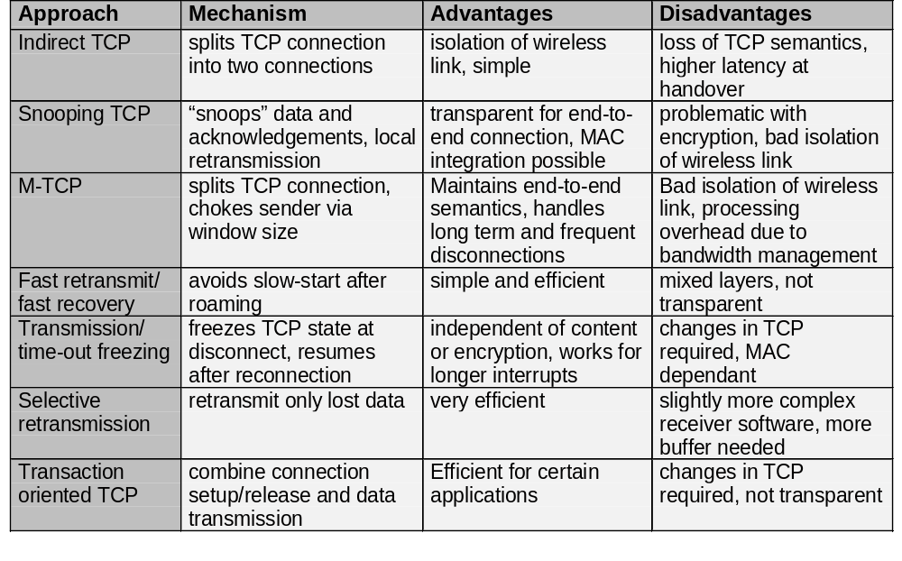
Comparison of different approaches for a “mobile” TCP

Slide 17
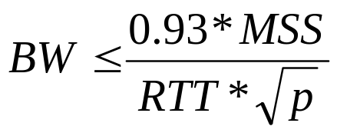
TCP Improvements I
Initial research work
  Indirect TCP, Snoop TCP, M-TCP, T/TCP, SACK, Transmission/time-out freezing, …
TCP over 2.5/3G wireless networks
  Fine tuning today’s TCP
  Learn to live with
    Data rates: 64 kbit/s up, 115-384 kbit/s down; asymmetry: 3-6, but also up to 1000 (broadcast systems), periodic allocation/release of channels
    High latency, high jitter, packet loss
  Suggestions
    Large (initial) sending windows, large maximum transfer unit, selective acknowledgement, explicit congestion notification, time stamp, no header compression
  Already in use
    i-mode running over FOMA
    WAP 2.0 (“TCP with wireless profile”)
max. TCP BandWidth
Max. Segment Size
Round Trip Time
loss probability

Slide 18
TCP Improvements II
Mobile system
Performance enhancing proxies (PEP, RFC 3135)
  Transport layer
    Local retransmissions and acknowledgements
  Additionally on the application layer
    Content filtering, compression, picture downscaling
    E.g., Internet/WAP gateways
    Web service gateways?
  Big problem: breaks end-to-end semantics
    Disables use of IP security
    Choose between PEP and security!
More open issues
  RFC 3150 (slow links)
    Recommends header compression, no timestamp
  RFC 3155 (links with errors)
    States that explicit congestion notification cannot be used
  In contrast to 2.5G/3G recommendations!
wireless
PEP
Internet
Comm. partner

